Slide 1
Enhancing Data Analytics Engineering (DAEN) Program Effectiveness: Analysis of Alumni Interview Feedback
James Baldo
Lingyun Dai

Slide 2


Researchers
James Baldo
Lingyun Dai
Director of DAEN Program at George Mason University
DAEN Student
Data Mining
Concentration

Slide 3
Table of Contents
01
Problem Statement
02
Solution Approach
03
Key Findings
04
Future Work

Slide 4
DAEN Program Overview
Industry-focused curriculum in tools, technologies, and methodologies
Prepares students for technical roles in data analytics and engineering

Slide 5
01
Problem Statement

Slide 6
Challenges
The main challenges were insufficient data, lack of an alumni feedback system, and low alumni engagement.

Slide 7
Understanding the Challenges
No Feedback System
Low Engagement
Lack of Data
No centralized alumni database
Limited alumni contact information
No feedback system established
No interview questions
Difficulty in motivating alumni to participate
Notes:
When contacting GMU Alumni office, they only have outdated alumni data instead of recent alumni data. The alumni office and the DAEN program have not been actively conducting interviews on the program feedback and analyzing the feedback results. It is difficult to motivate the alumni to provide feedback to the program.

Slide 8
Goals
The research aimed to evaluate program effectiveness, understand alumni career trajectories, assess skill utilization, and guide program improvements.

Slide 9
Understanding the Goals
Program Effectiveness
Career Trajectories
Analyze employment outcomes
Assess program satisfaction and value
Identify areas for curriculum enhancement
Track job titles and companies
Measure job mobility patterns Identify common career paths

Slide 10

Understanding the Goals
Technical Skill Utilization
Program Improvements
Determine most used technologies and tools
Compare skills learned to industry requirements
Identify emerging technology trends
Identify curriculum gaps
Capture industry needs for new skills
Prioritize updates based on alumni insights

Slide 11
02
Solution Approach

Slide 12
Solution Approach
Research Methodology
Data Processing
Outcomes
Structured 11-question interviews
Contacted 50+ alumni, conducted 14 interviews
Multiple data collection methods (Teams, Zoom, LinkedIn)
AWS and NLP for interview data processing
Tableau for employment, skills, satisfaction analysis
Program improvement recommendations synthesized
Initial alumni database created
Foundation for ongoing engagement and assessment

Slide 13
03
Key Findings

Slide 14
Percentages
43%
43%
78%
Held two jobs since graduation
Data Analyst
Python and SQL usage in programming language

Slide 15
Percentages
47%
55%
100%
AWS Usage in Cloud & Infrastructure
Spark and Databricks Usage in Big Data & AI
MS Degree Type

Slide 16
Percentages
28%
33%
56%
Alumni Response Rate
Snowflake Usage in Database & Data Storage
MS Power BI and Tableau usage in Business Intelligence & Visualization

Slide 17
DAEN Program Average Rating
3.7/5

Slide 18
Visualizations
Academic Profile Assessment
Career Progression Tracking
Post Graduation Development
Technical Skill Utilization
Program Value Assessment

Slide 19
Visualizations
Academic Profile Assessment

Slide 20
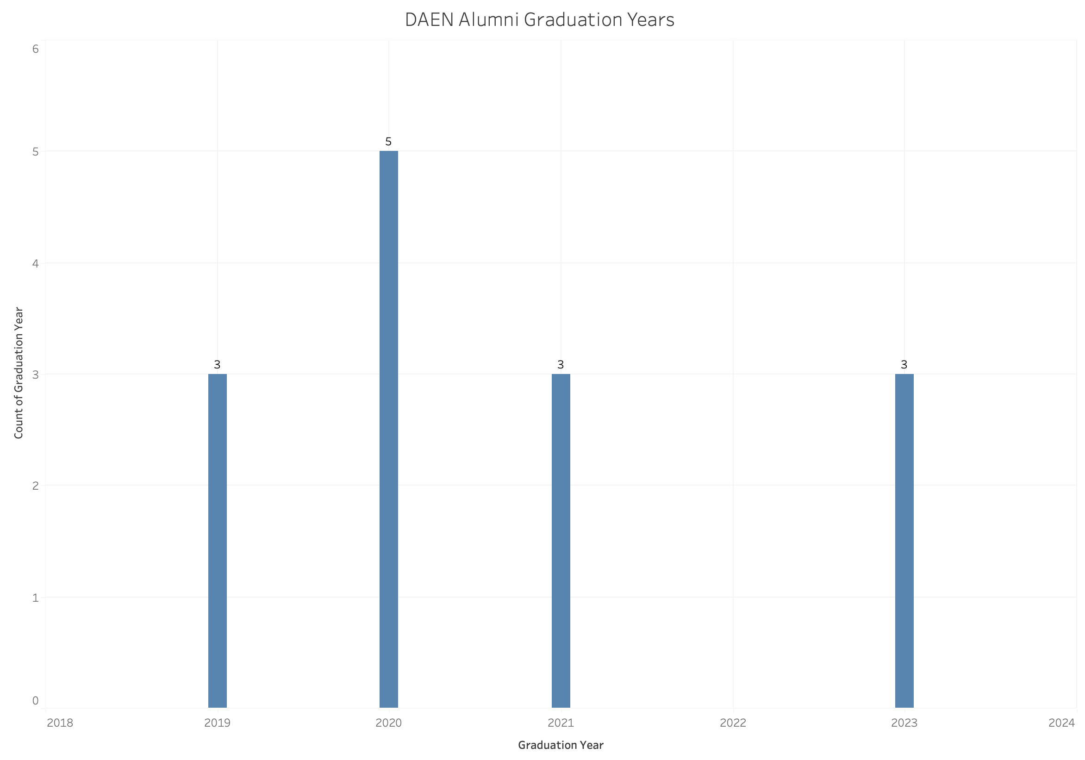

Slide 21
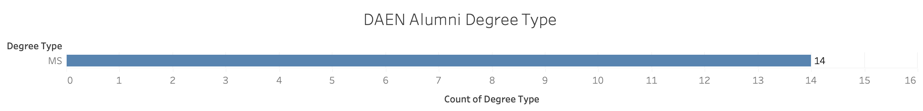

Slide 22
Visualizations
Career Progression Tracking

Slide 23
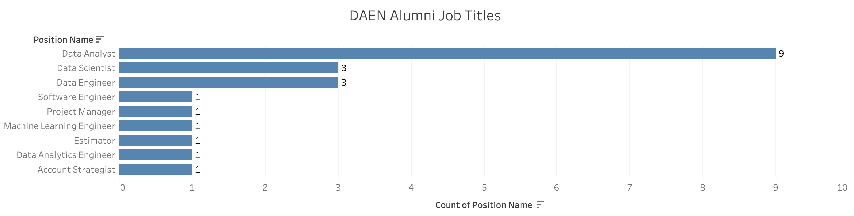

Slide 24
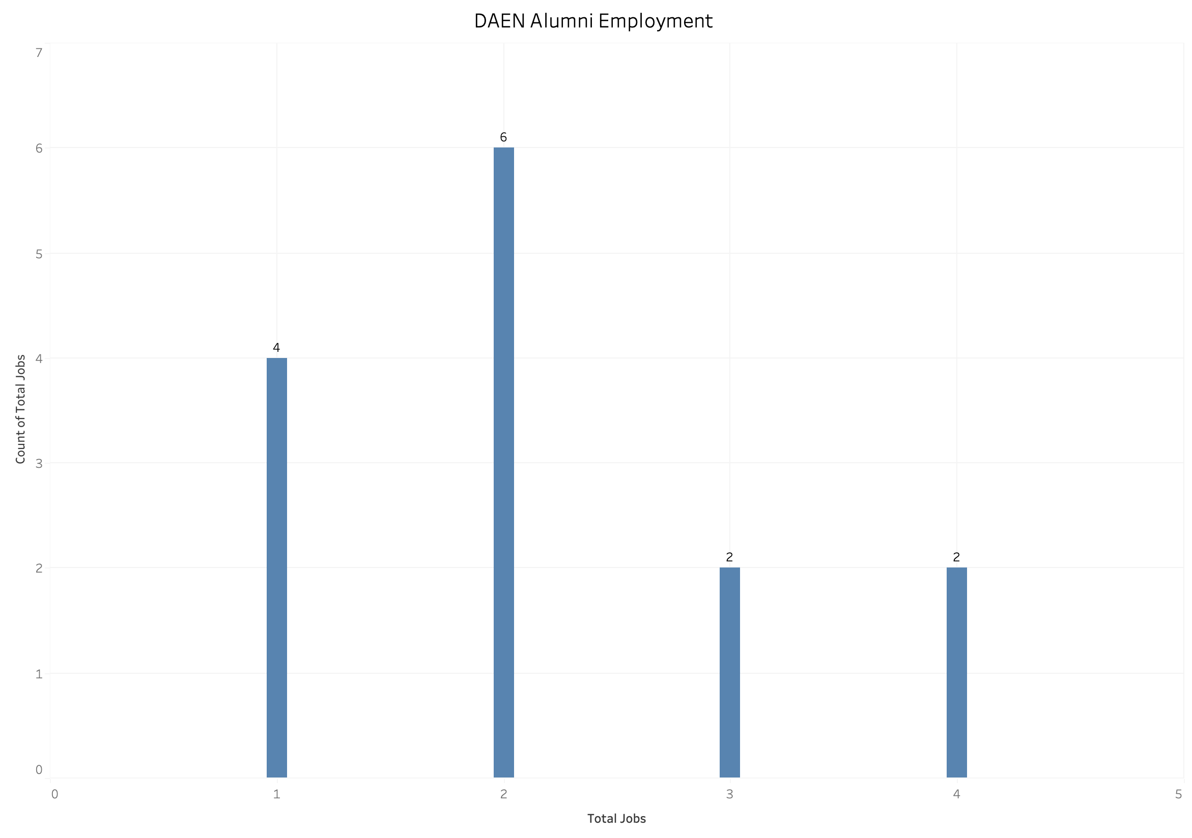

Slide 25
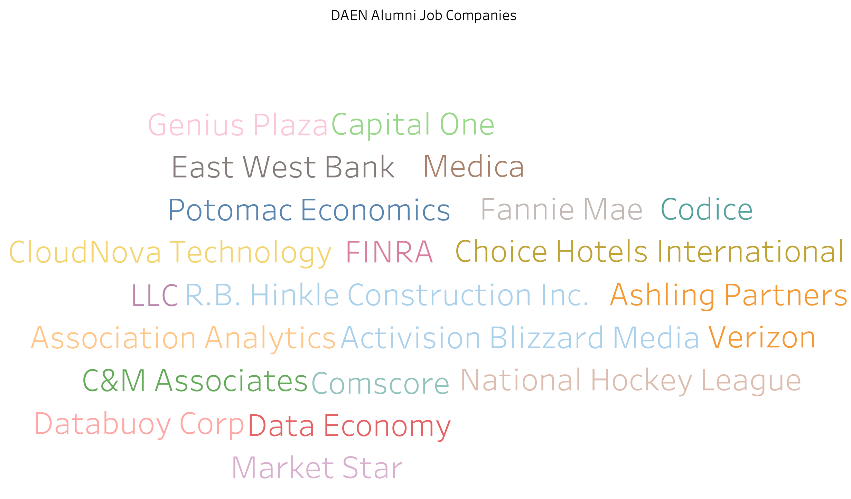

Slide 26
Visualizations
Technical Skill Utilization

Slide 27
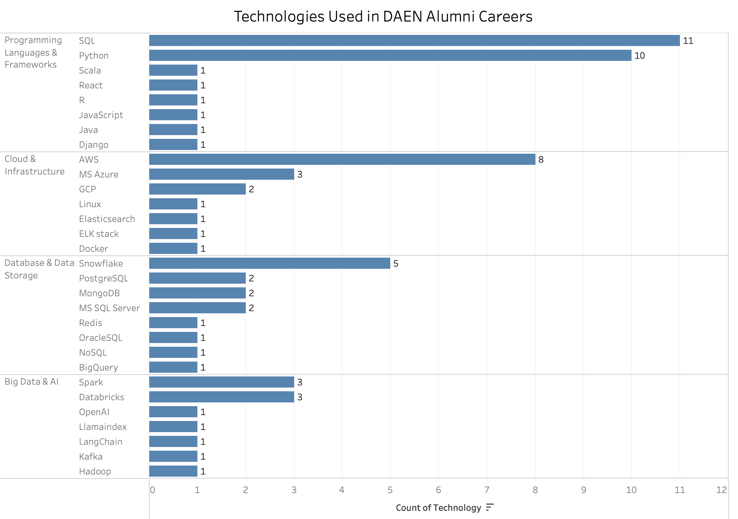

Slide 28
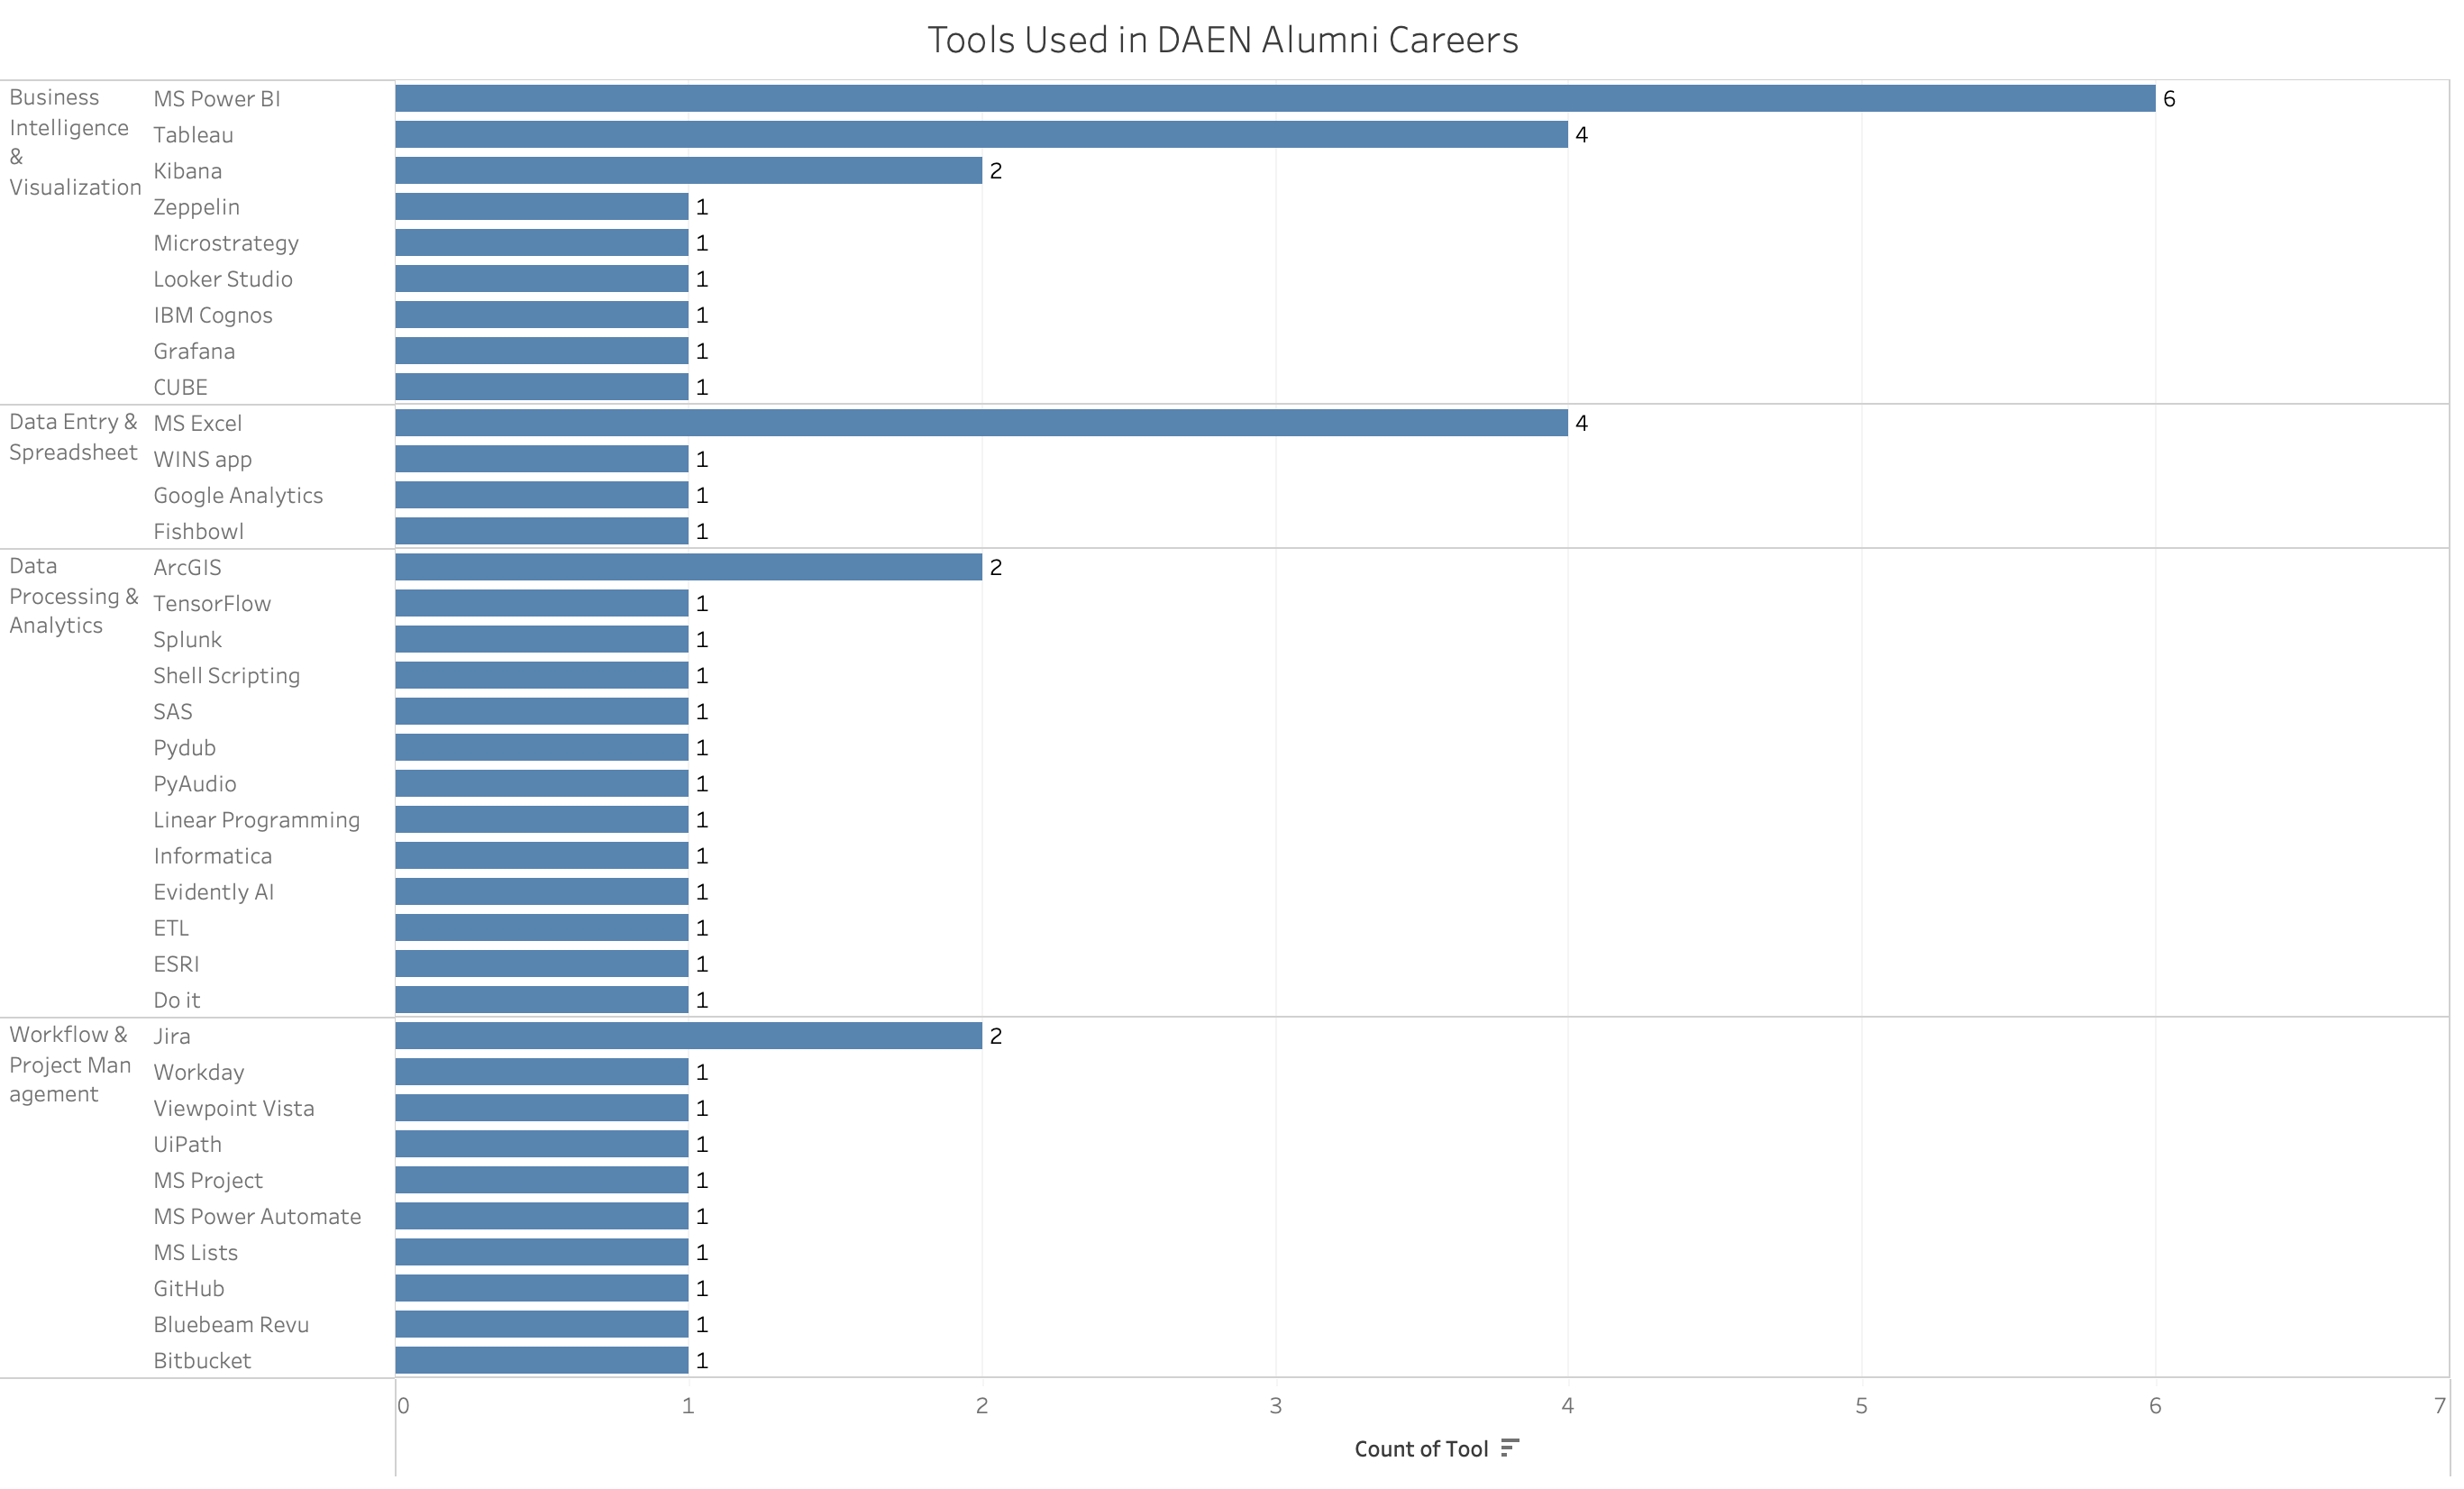

Slide 29
Visualizations
Program Value Assessment

Slide 30
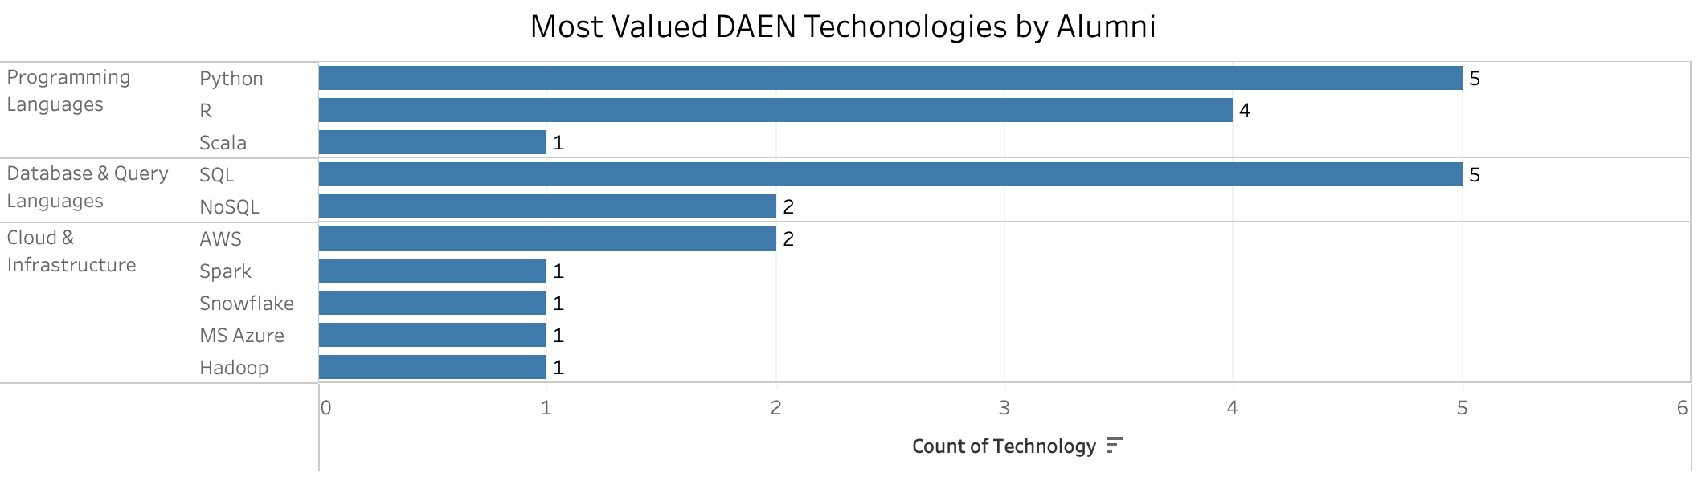

Slide 31
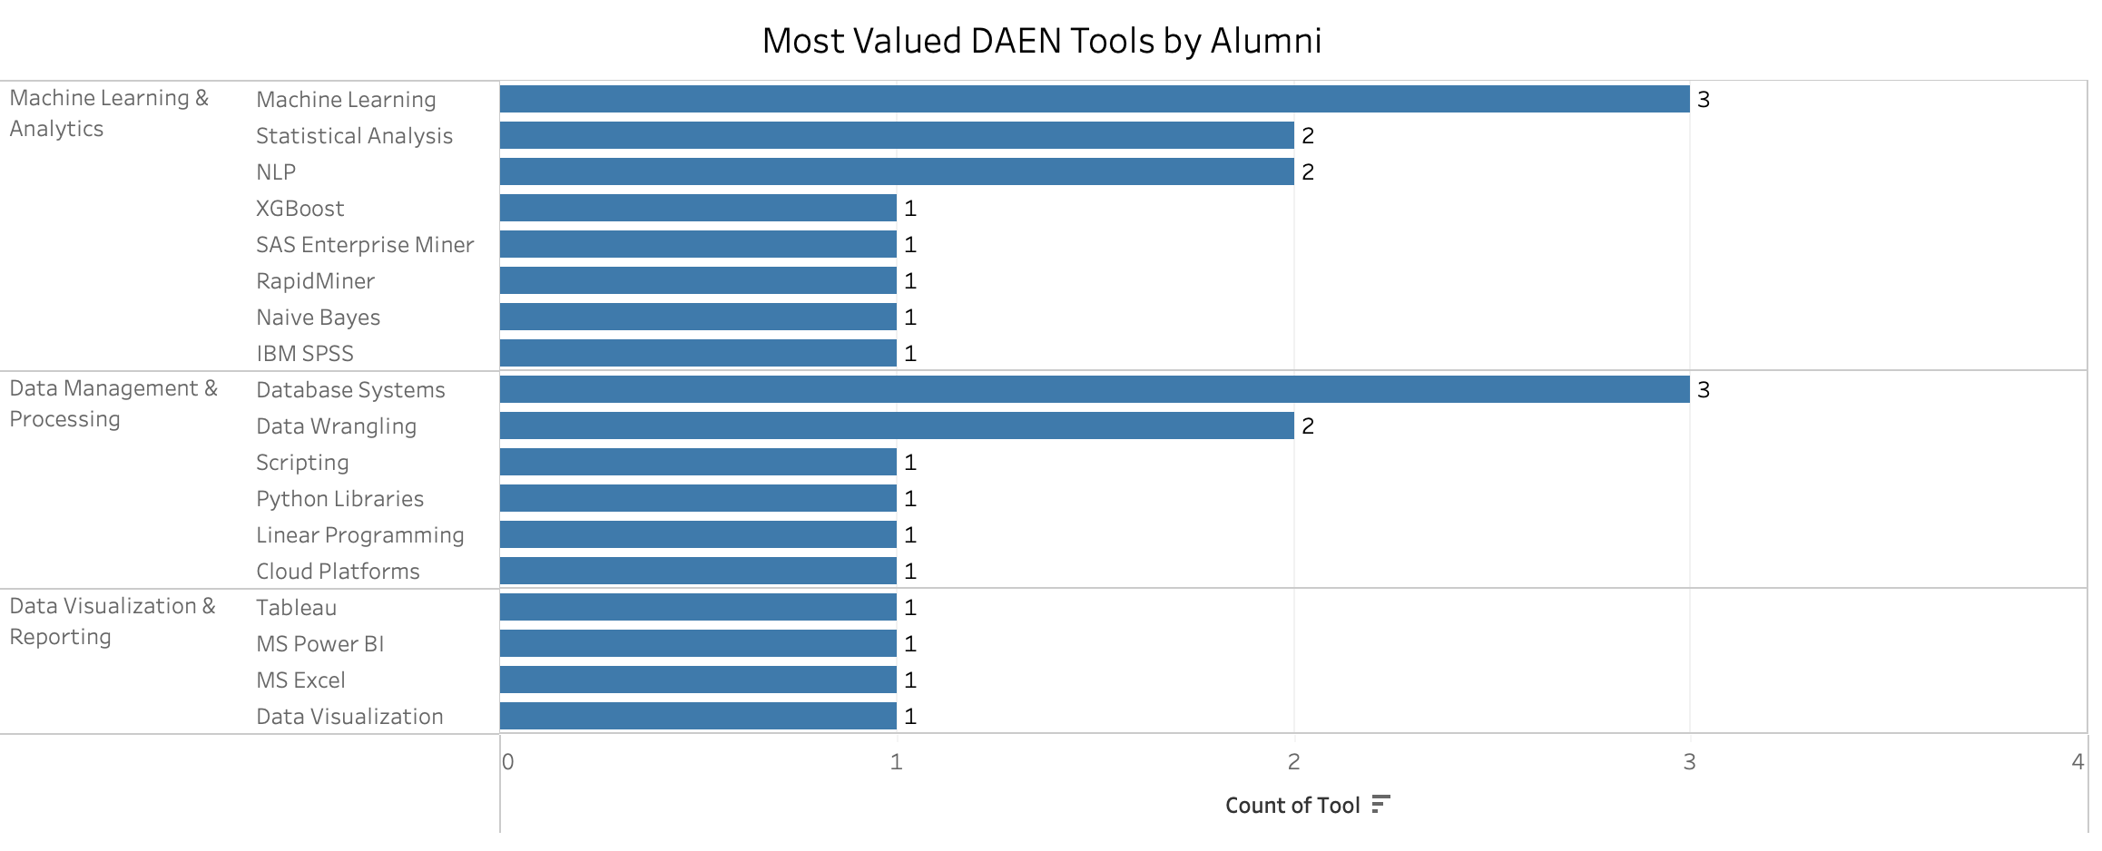

Slide 32
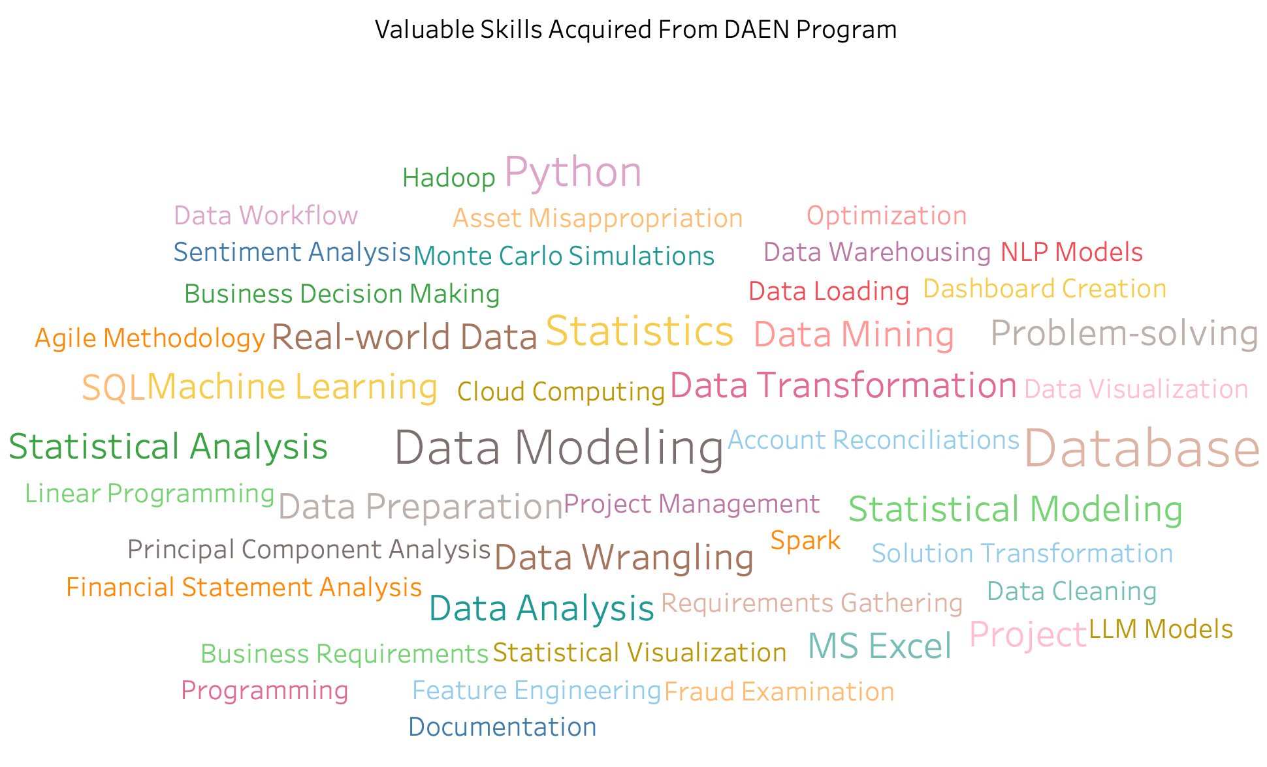

Slide 33
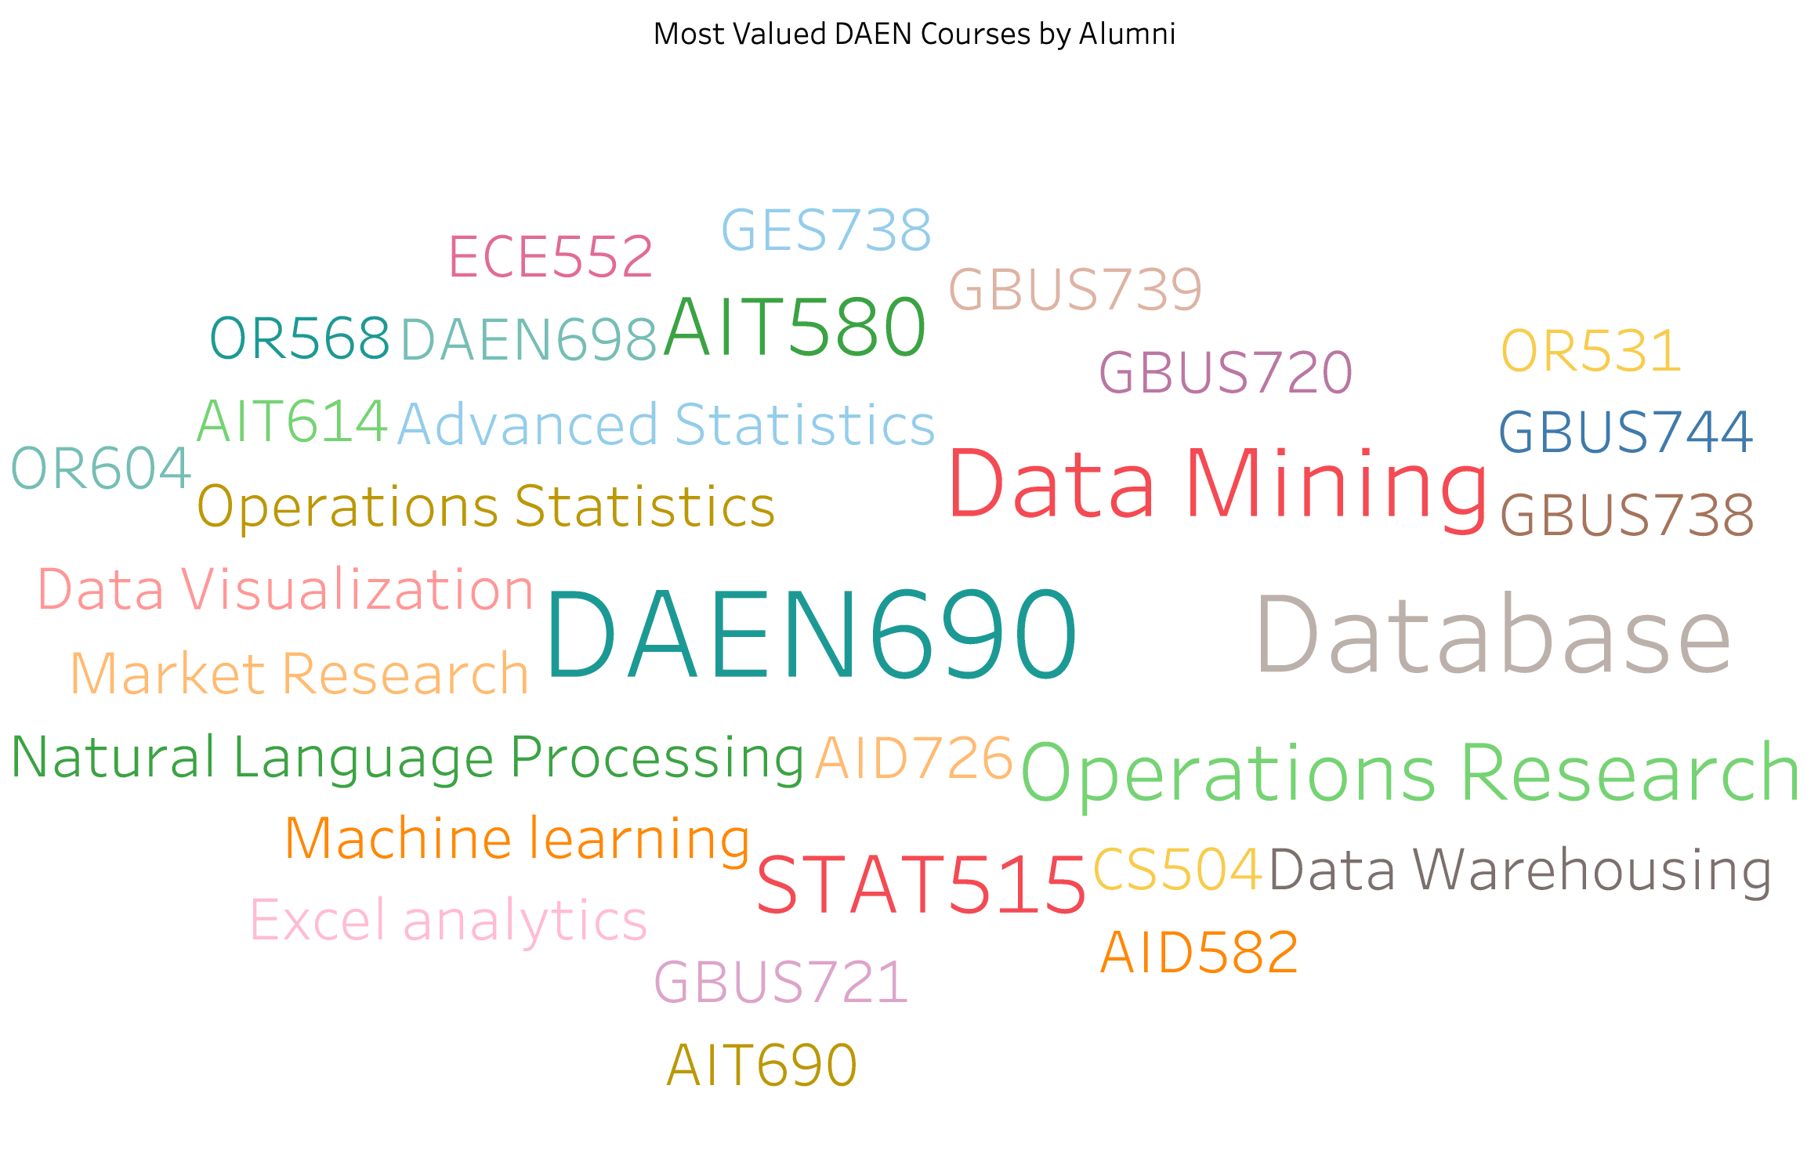

Slide 34
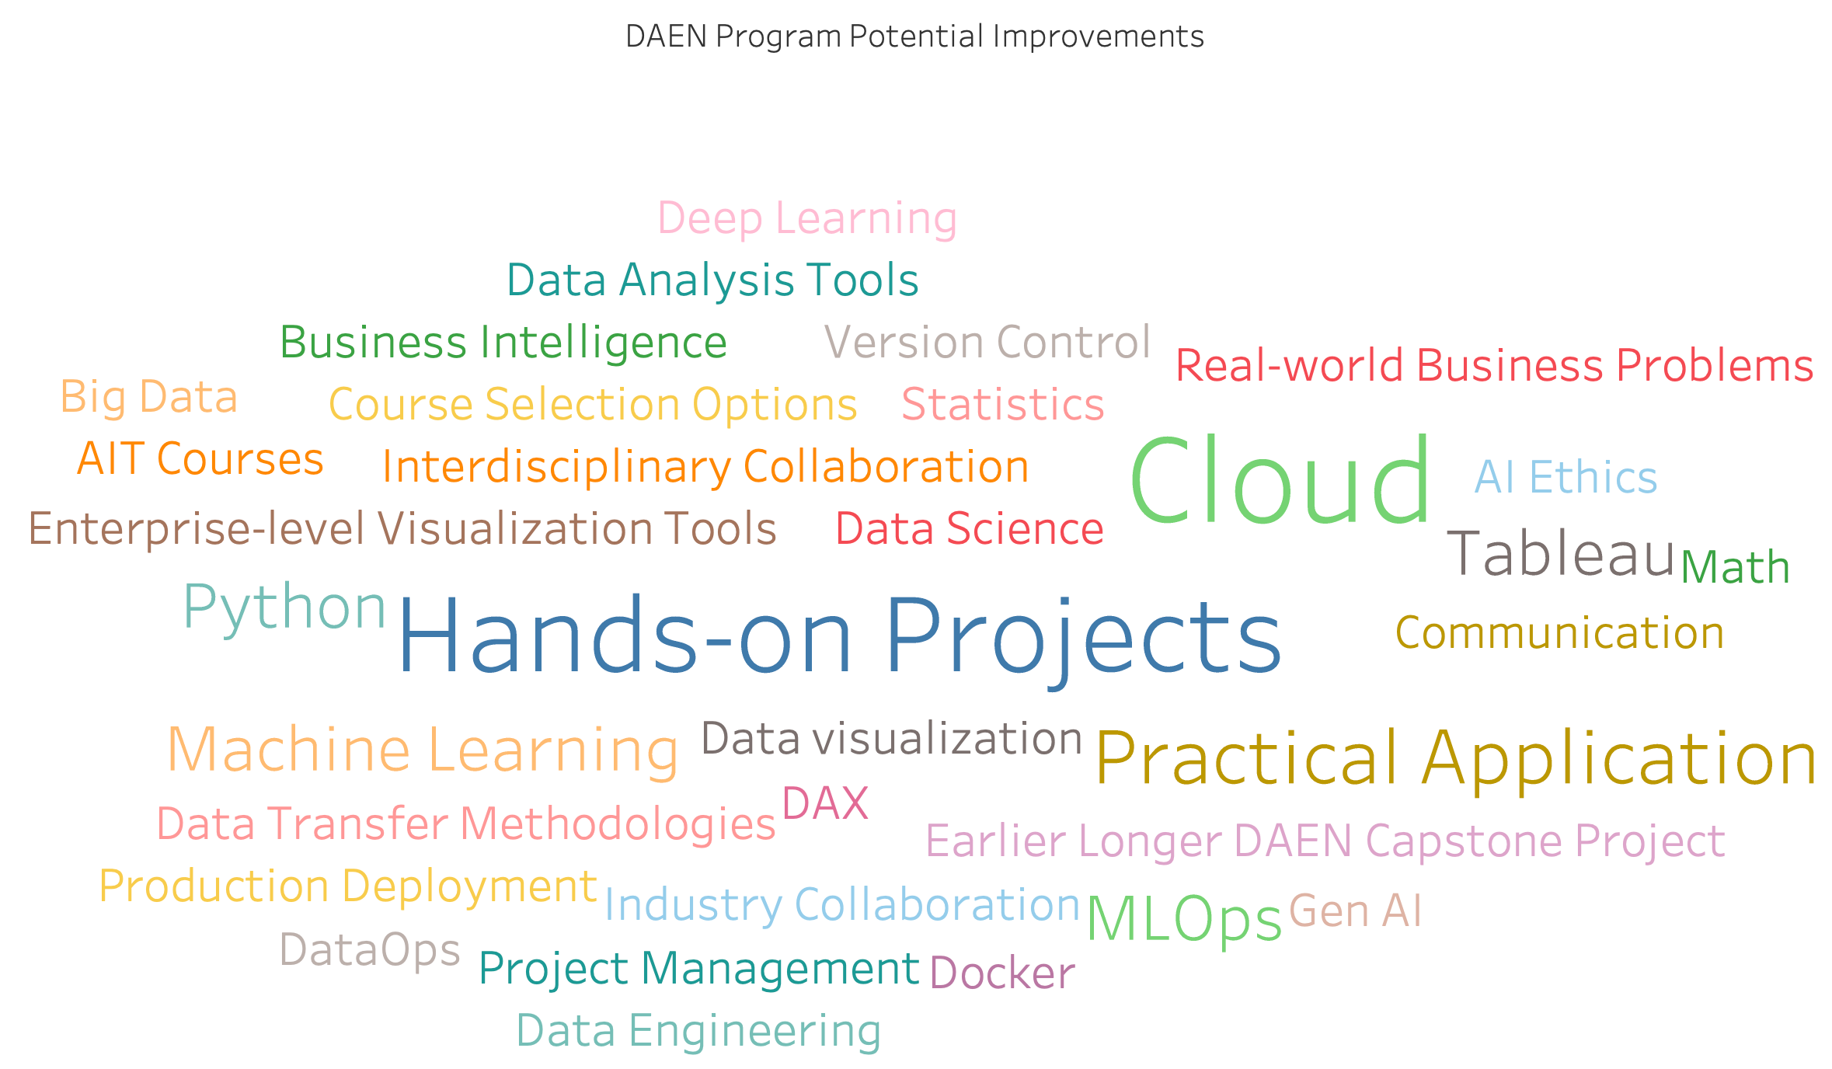

Slide 35
Visualizations
Post Graduation Development

Slide 36
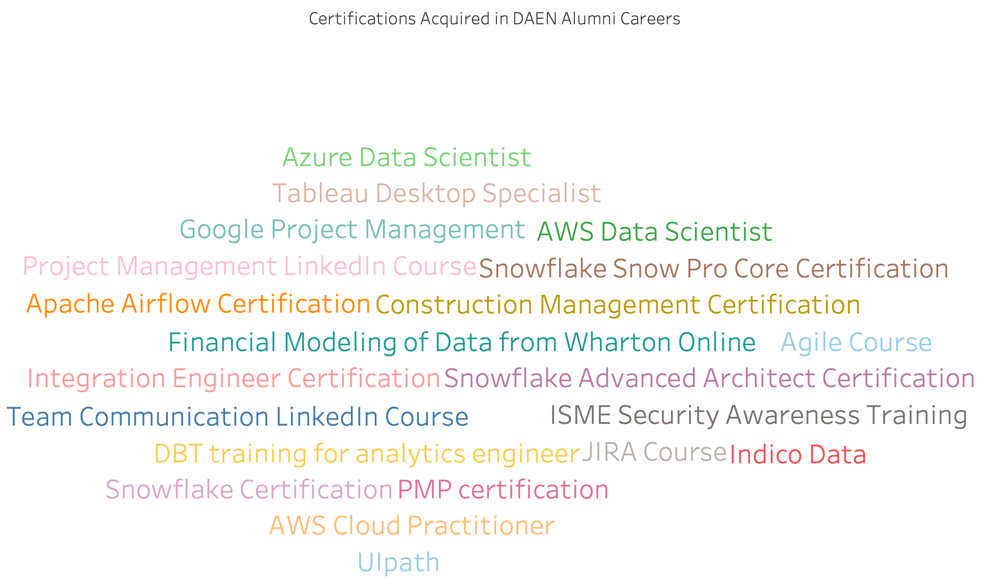

Slide 37
Next Step
Program Development
Data Pipeline Development
Database Infrastructure Implementation
Quality Assurance Systems
Survey Operations
Survey Design Process
Response Collection System
Results Analysis Framework
Curriculum Enhancement
Cloud Computing Integration
Certification Preparation Materials
Industry Tools Update
Alumni Engagement
Mentorship Program Development
Professional Events Organization
Alumni Resource Center

Slide 38
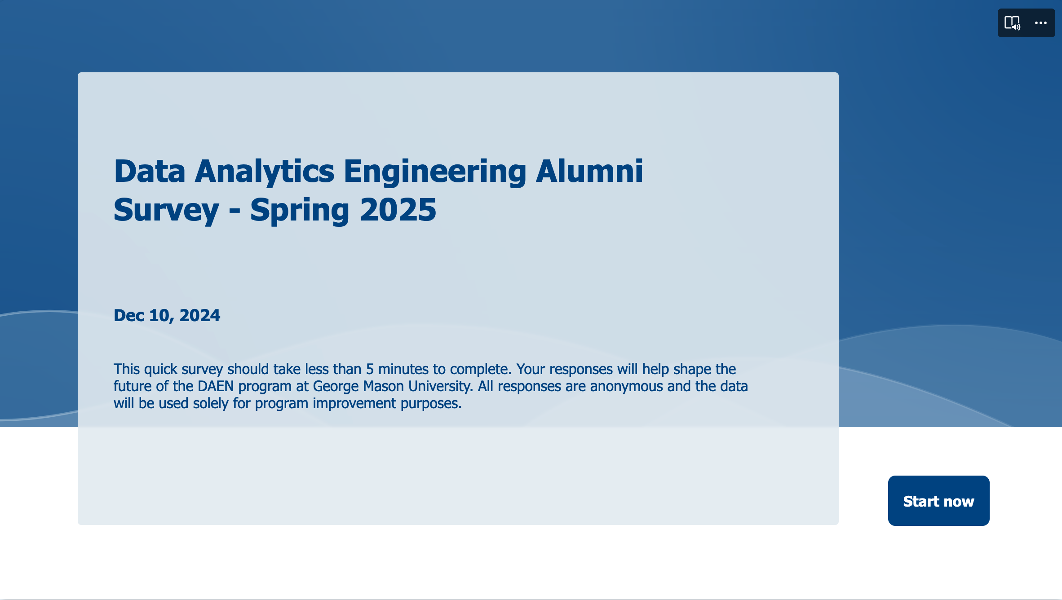
DAEN Alumni Survey
Proposed Release Date:
February 1st, 2025

Slide 39
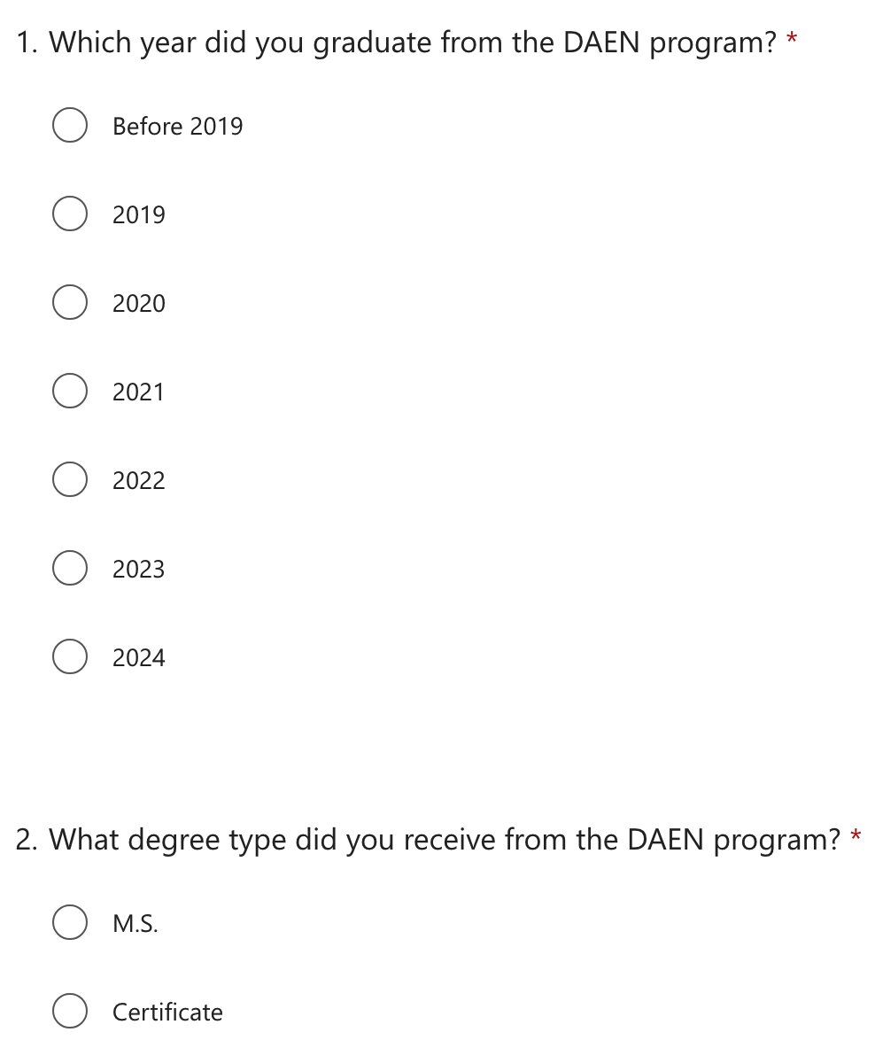
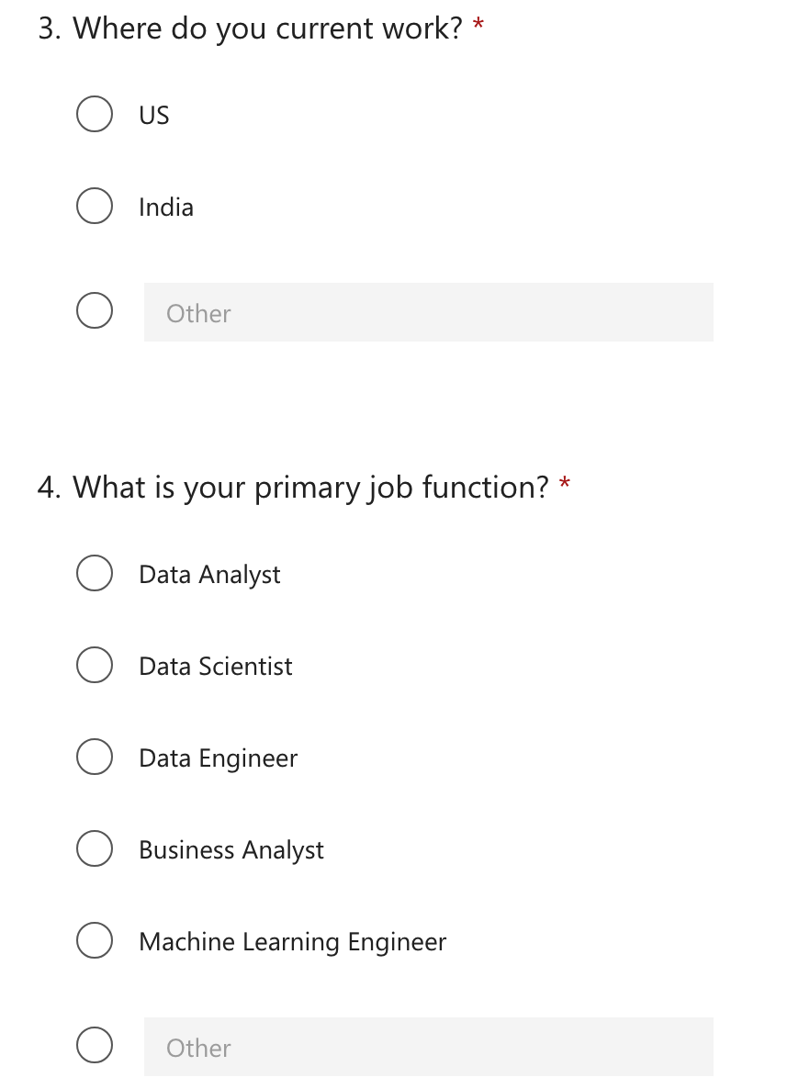

Slide 40
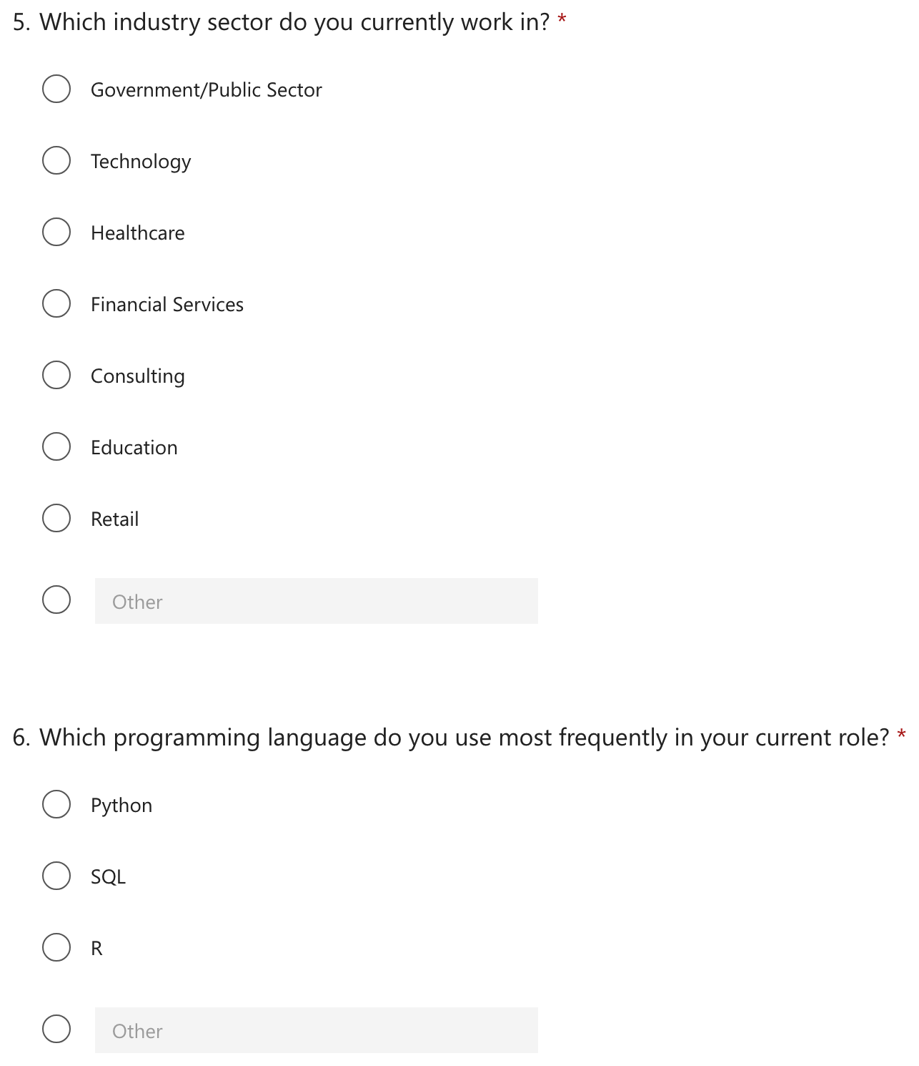
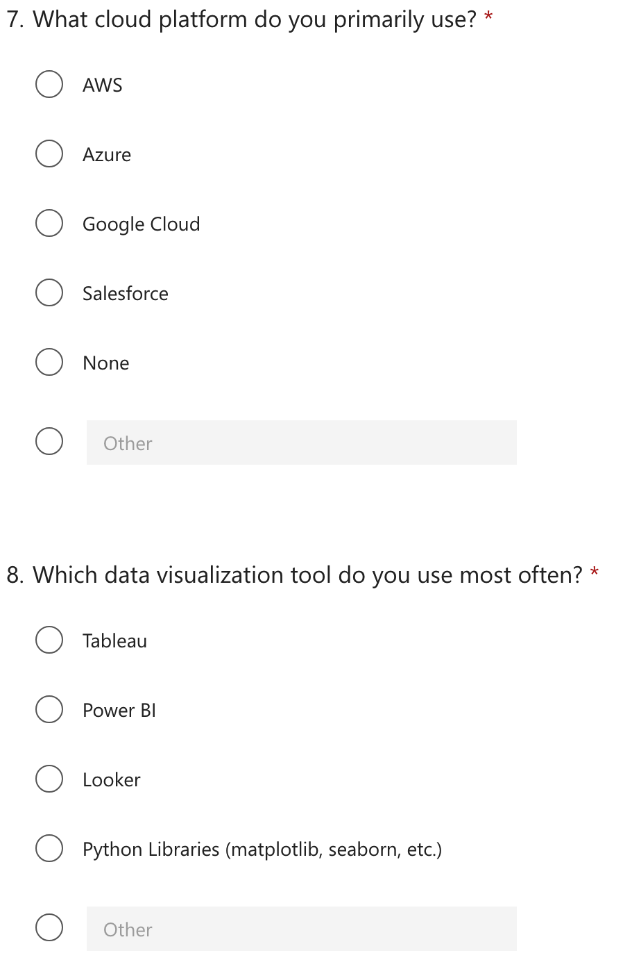

Slide 41
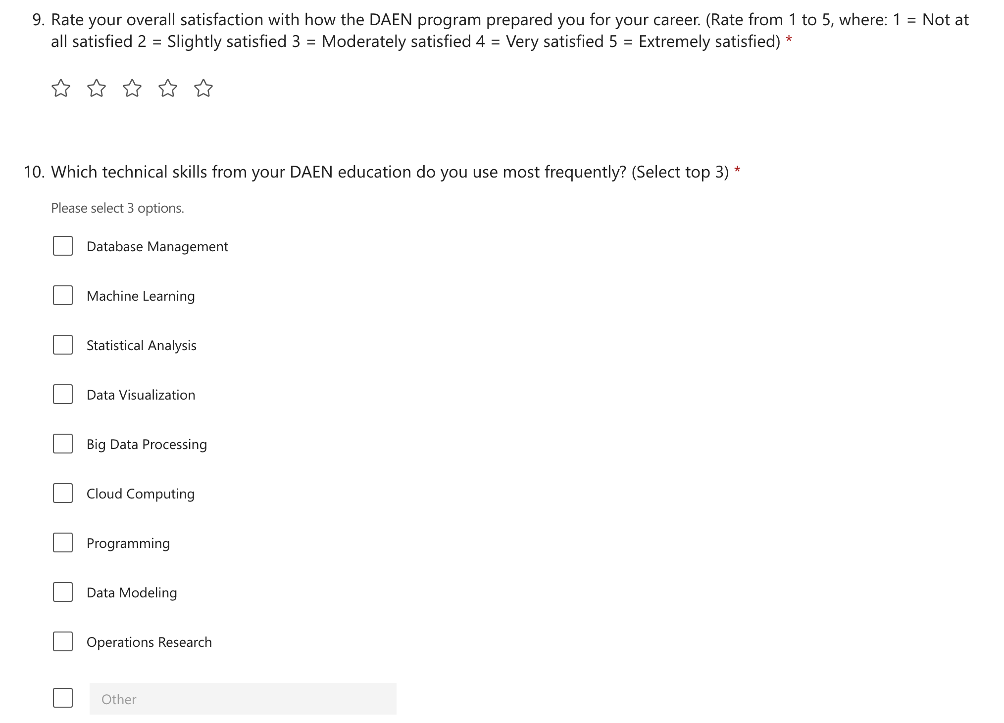

Slide 42
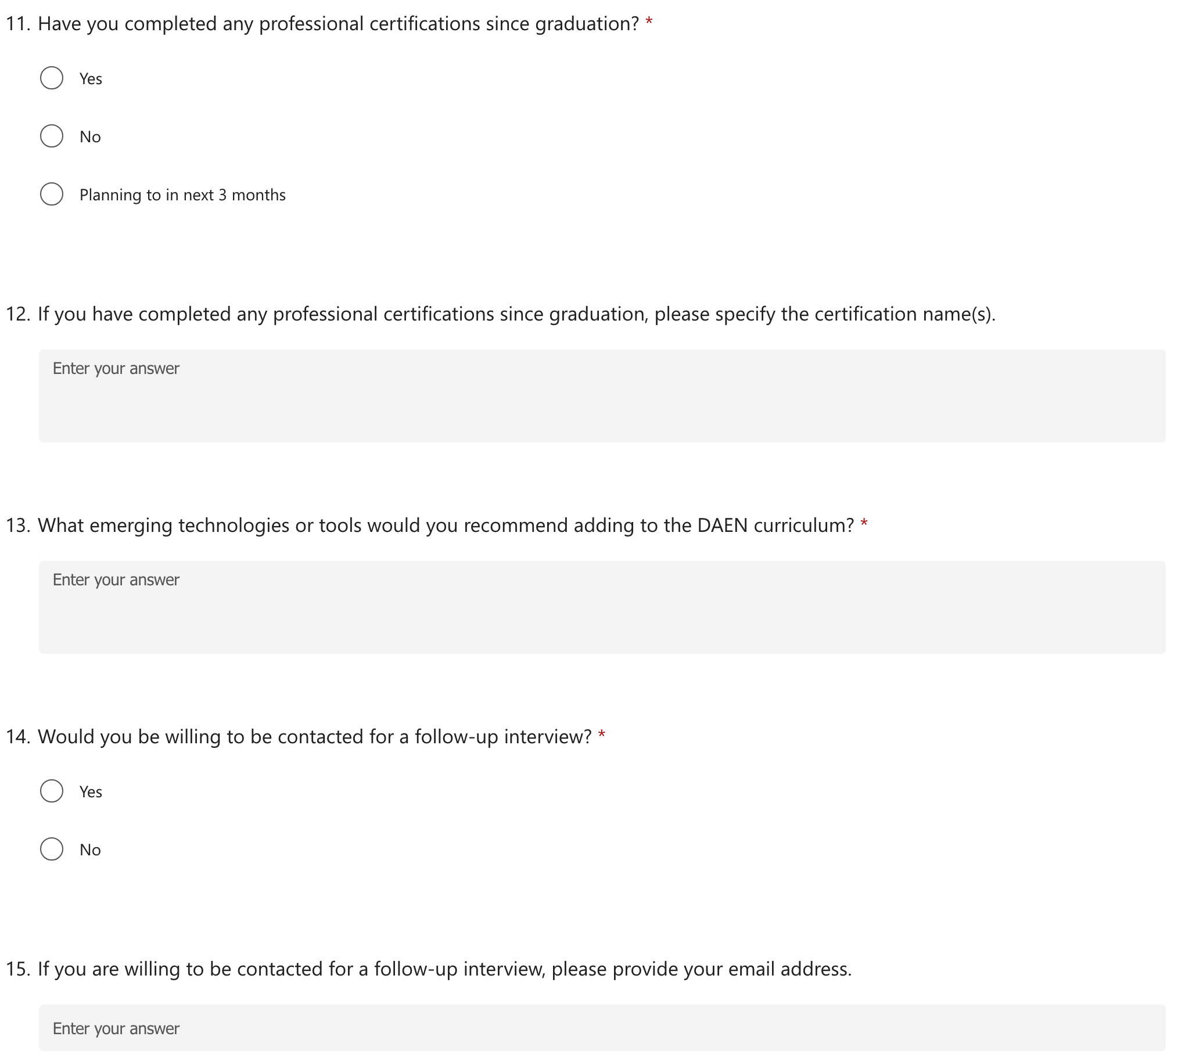

Slide 43
Thanks
Do you have any questions?
Send an email to
James Baldo jbaldo@gmu.edu
Lingyun Dai ldai2@gmu.edu

